Slide 1
AIMAX Digital Marketing Mix Optimizer
March 2020

Slide 2
Digital trends in pharma indicate a transformation in customer engagement models
the line between traditional and digital marketing is getting blurred …..
The New Normal
54% of Outperforming organizations are more likely to collaborate deeply with customers
Digital touch points gain ground
8 out of 10 Patients are online several hours a day and prefer Pharma companies reach them through digital channels
Pressure for differentiate
43% of marketers say connecting
with customers is their biggest
challenge
Returns on digital dollars
56% of doctors who use mobile devices say they expedite decision making
Marketing holding the line
Digital distinction
Marketing budgets remains steady at >10% revenue and 80% of companies will develop a digital business strategy, but only 20% will create an all-encompassing and actionable plan by 2017
68% of companies still keep a separate budget for digital marketing comprises ¼ of total marketing budget, on average
Worth the Investment
79% of Marketing departments continues to hold a capital budget, primarily for marketing technology investment
Stretching the digital budget
>70% of companies are funding digital marketing campaigns by reinvesting saving and justifying incremental investments to get better ROI

Slide 3

AIMAX - helps the marketers to answer these key business questions
How to identify right engagement channels for better results
What is the channel-wise impact of promotions on product sales and growth
How can I improve my ROI by Optimizing marketing budget allocation and spends across marketing channels
What would be the future market scenario of a product based on chosen promotional strategies
How to target specific competitors by strategizing channel wise spend in order to gain market share

Slide 4





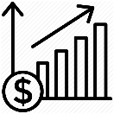




AIMAX – Digital Marketing Mix Optimizer
An advanced marketing analytics solution that leverages a thorough data strategy coupled with advanced analytics methodologies to drive customer insights for sales and marketing
Holistic approach takes into account all available and meaningful information about the customer and turns customer interactions across channel into actionable insights
Customer Data Center
Advanced Analytics & Insights
Personalization
Strategic Approach
Omni-channel data integration for holistic customer and business performance view
Sophisticated analytics to deepen customer and business insights for better ROI
Redefine the way to engage and drive top-line revenues through personalization
360°view of market and product to enable proper planning and execution
Advanced Analytics Reusable Assets
Pre-launch Sales Forecasting
Digital Influence on Customers
Right Channel Mix Identification
Promotional Spend Optimization
Market Forecasting
Predict sales for a new product leveraging market and competitor performance and trends to simulate the future outcomes
Measure the effect of digital channels and identify right engagement channels for marketing strategy
Identify the optimal Multi - Channel Mix for promotion activities
Evaluate channels for promotion response and optimize the spend across the channels
Leverage past promotion data and predict how proposed promotions may affect the future
4

Slide 5



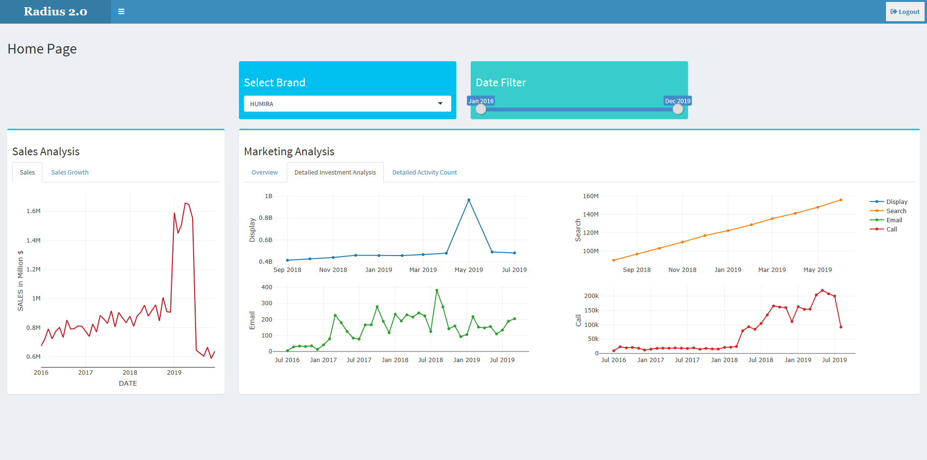
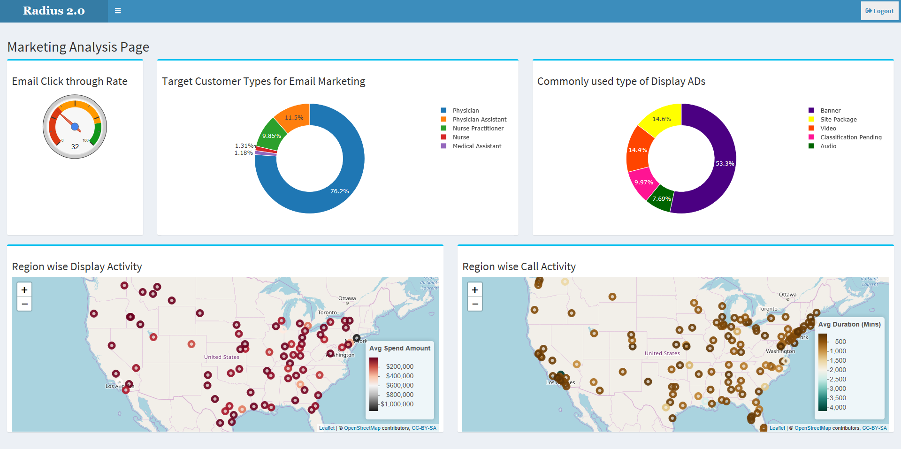
Use case 1 – Multi-channel Promotion Analysis
Leverage the data from promotional channels to understand the nature and investment on channel-wise promotions and check their effectiveness and impact on Sales
Situation: Pharmaceutical companies allocate the marketing budget in multiple promotional channels where the returns are difficult to measure
Solution: To develop the best multi-channel promotional strategies by identifying the channel-wise returns and impact of promotions on Sales
Inputs
Approach
Output/Result
Aggregated the product level monthly sales and promotional spend data for all channels
Built a regression model to determine and measure the impact of channel-wise promotions on total product sales
Analyzed multiple KPIs to conduct detailed analyses on the nature of multi-channel promotions and investment made on each channel
Calculated the sales growth of products in a particular market
Performed ROI Analysis on each promotional channel to identify the best performing channels
Multi-channel promotional data for different products and markets
Email Campaign Data
Display Campaign Data
Search Campaign Data
Call Activity data
Sales data
Helpful for pharma clients to analyze online conversions and understand how they are evolving and spreading
Understand the promotional spending based on different promotional channels and its effect in overall sales of product
Improve ROI by Optimizing marketing budget allocation and spends across marketing channels
Identify a benchmark for measuring the performance of products with respect to the competitors

Slide 6
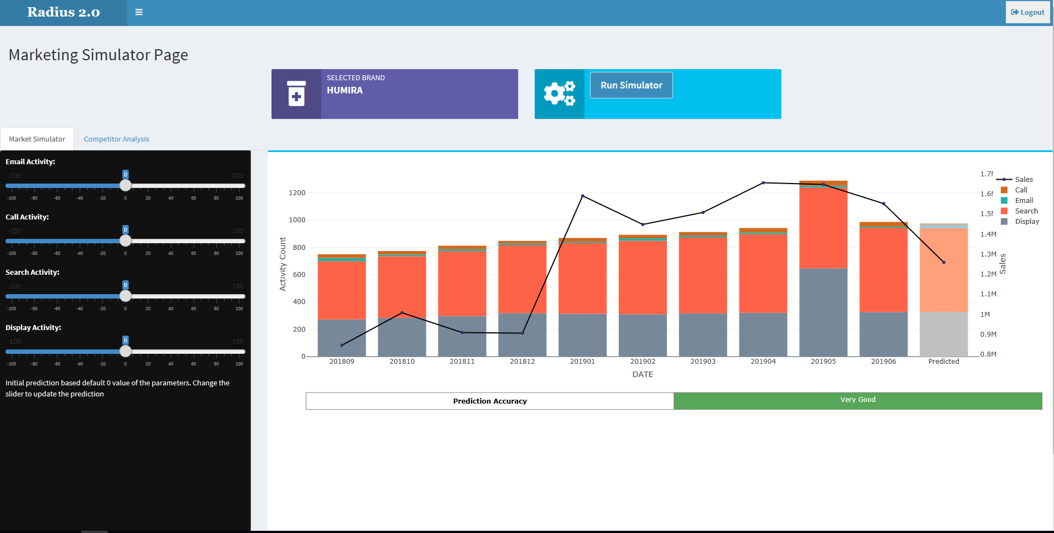
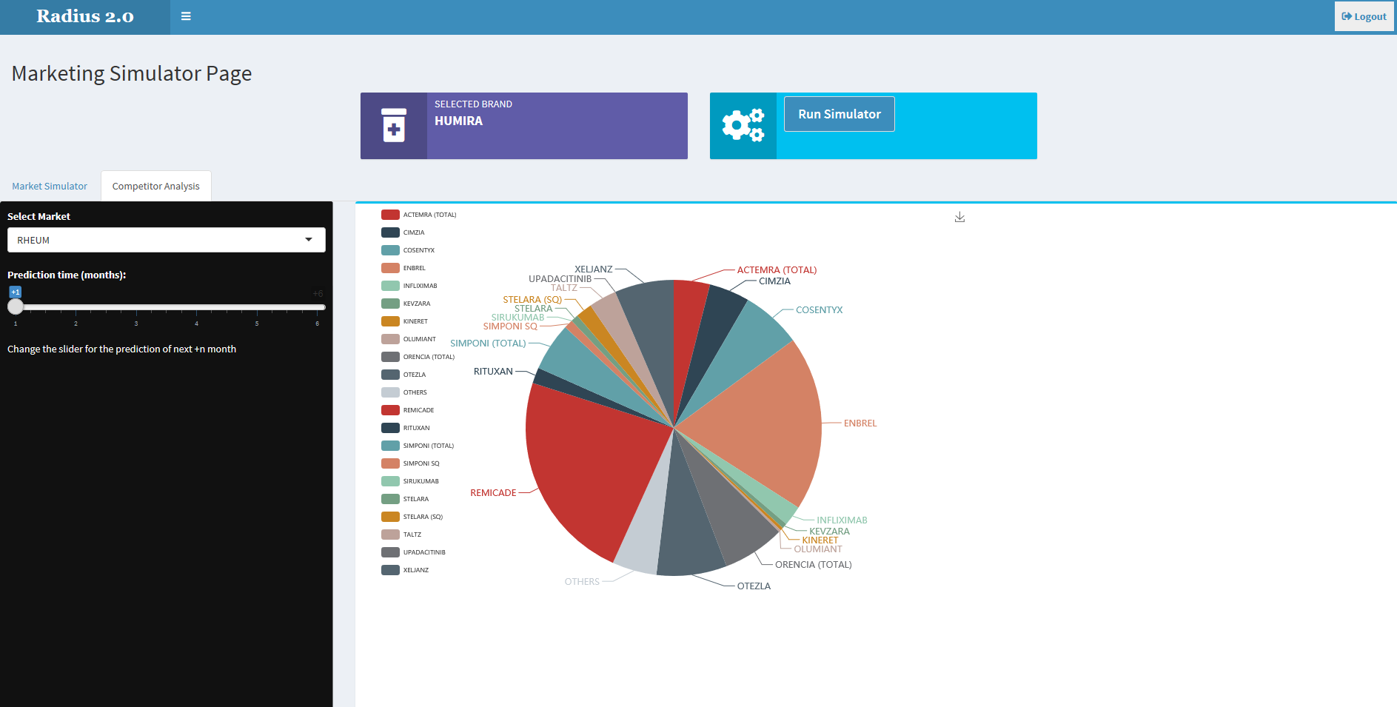
Use Case 2 – Market Simulator for forecasting future market events
Leverage past promotion and sales data and simulate the future outcomes
Situation: Based on historical sales and promotional data for a drug, predicting how proposed promotions may affect the future performance
Solution: Generated drug sales simulates the future market situation taking into account appropriate market conditions including promotions and competitors performance
Inputs
Approach
Output/Result
Brand level monthly sales and promotional spend data for all channels is aggregated.
Forecasted the product sales on the basis of historical data where promotional channel spending is taken as input variable and Market Rx is taken as output variable
Increasing/Decreasing promotional channel activity will lead to the prediction of future sales using appropriate regression model
The historical data from Market Rx of competitor as well as own product is used for time series analysis
Aggregation of all the product sales from individual market will lead to determination of overall market scenario in the future
Monthly Brand Rx
Emails
Call Activity
Monthly spend on each promotional channel
This type of time series analysis may aid in
Determining how past promotions affected the historical sales
Predicting how proposed promotions may influence the future
Recommendation of sales strategies on the basis of appropriate chosen promotional mix
Forecasting the market scenario till 6 months in the future, on the basis of existing implementation of promotional strategy

Slide 7





High-level Solution Architecture
Leverages data from digital & traditional channels and applies advanced analytics methodologies to drive insights for customer centric marketing
Data Layer
Processing
Analysis
Digital data
Data Integration
Sales Analysis
Email Campaign Data
Data Validation
Display Campaign Data
Marketing Investment Analysis
Search Campaign Data
Business rules implementation
ROI Analysis
Traditional data (Offline data)
KPI framework
Sales data
Competitor Performance Analysis
Call Activity data
Advanced Marketing Analytics models
Market Rx data
Market Simulator
Platforms
Flat Files
SQL Lite

Slide 8
Application Structure
Home Page
Marketing Analysis
Marketing Simulator
ROI Analysis
Upload Data
Home Page
Marketing Analysis
Marketing Simulator
ROI Analysis
AIMAX
NEXT GEN MARKETING ANALYTICS SOLUTION
ADMIN LOGIN
OTHER USER LOGIN
1. Dashboard Home Page
2. Marketing Analysis
3. Market Simulator
4. ROI Analysis
5. Upload Data
Brand Filter
Time Filter
Email Click through Rate
Target Customer types for Email
Commonly Used type of Display Ads
Region wise Display Activity
Region wise Call Activity
Brand Filter
Overall ROI of marketing campaigns
Call Activity
Email Activity
Display Activity
Search Activity
Select File Type
Download Template option
Upload Button
Selection of Sheet Number
Save File Button
Sales
Sales (Units)
Sales Growth %
Marketing Analysis
Overview
Overview of Investment
Overview of Activity
Detailed Investment Analysis
Call
Email
Display
Search
Detailed Activity Count
Call
Email
Display
Search
Sales Prediction by changing filters
Call
Email
Search
Display
Prediction Accuracy
Competitor Analysis
filters
Brand
Prediction Time in Months

Slide 9
Thank you

Slide 10
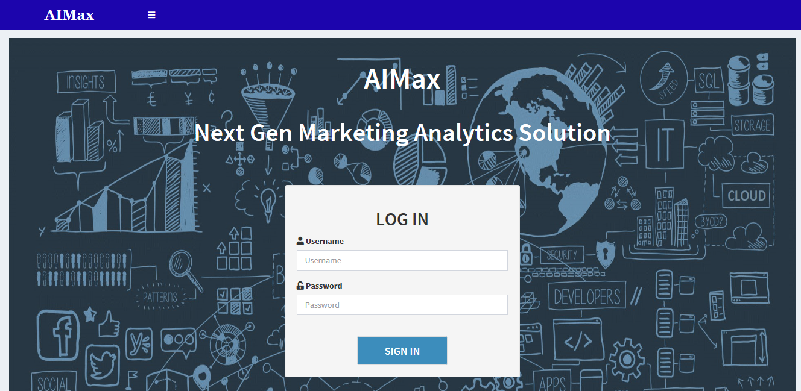
APPENDIX 1- Application Screenshots
AIMAX Homepage

Slide 11
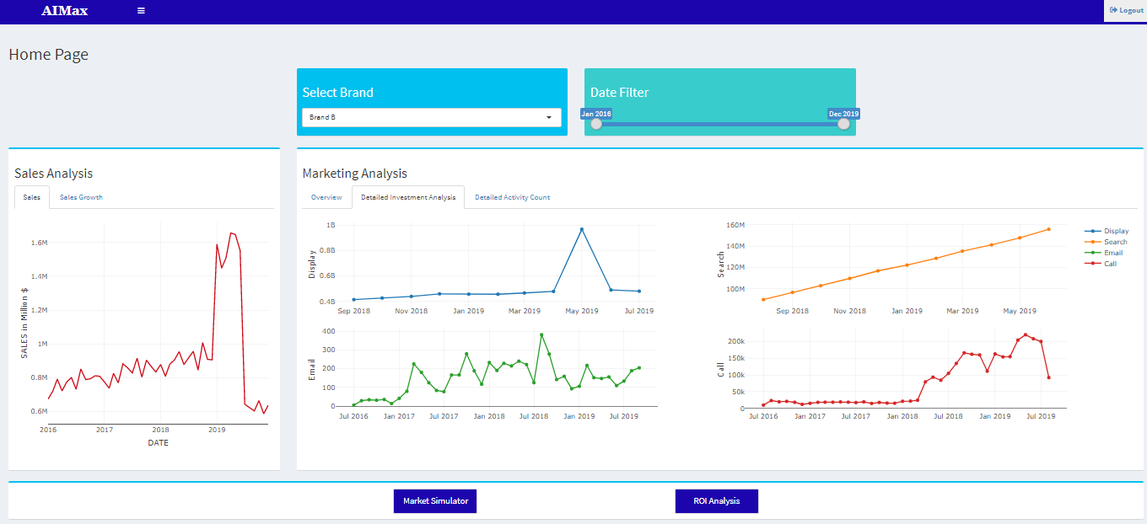
Dashboard Homepage

Slide 12
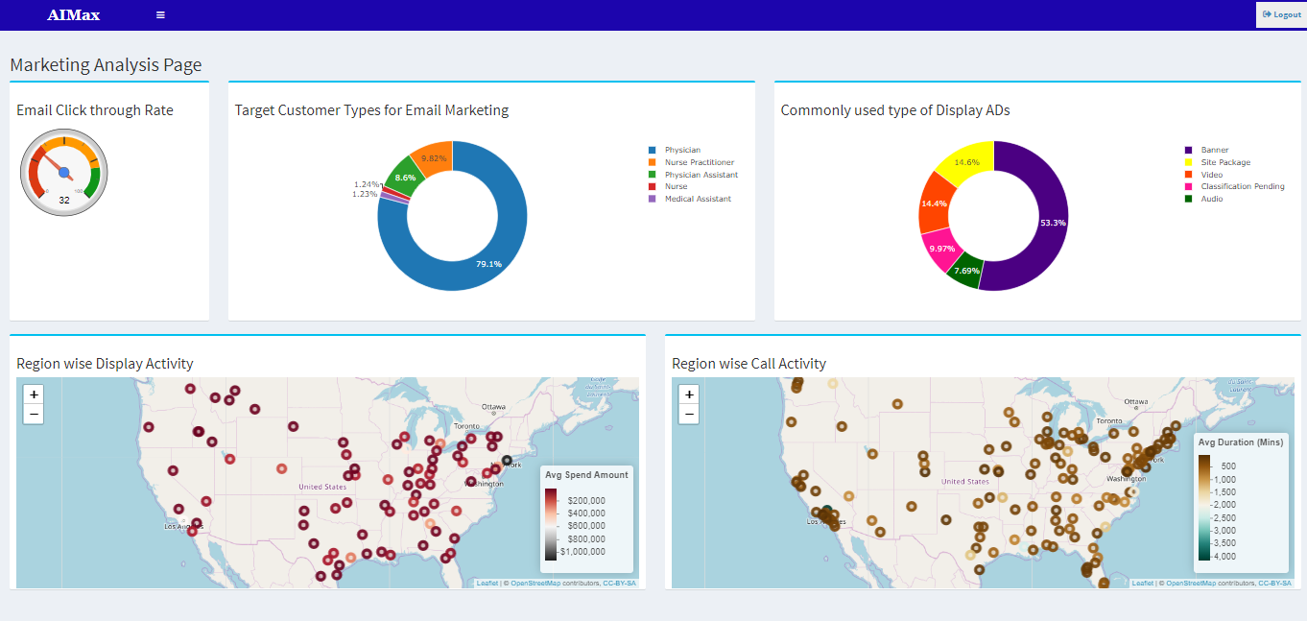
Detailed Marketing Analysis Page

Slide 13
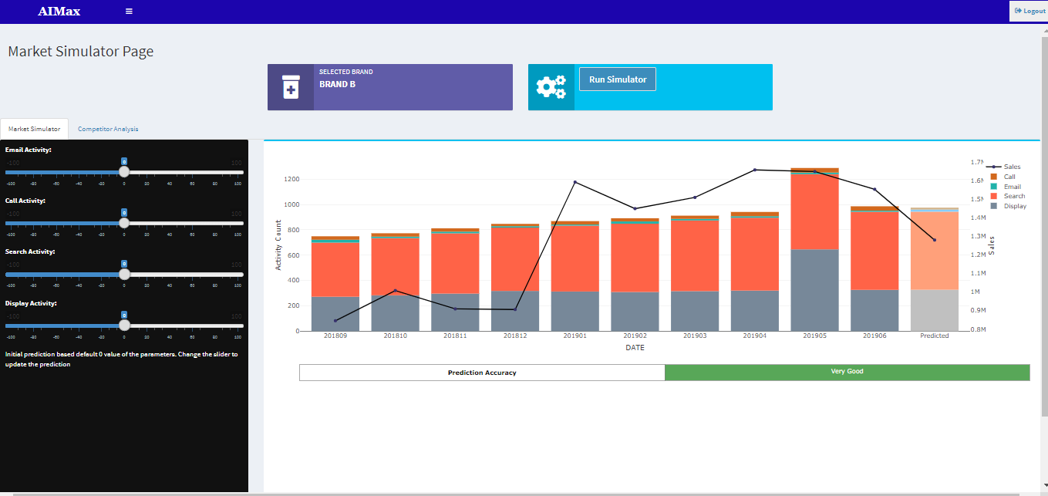
Market Simulator

Slide 14
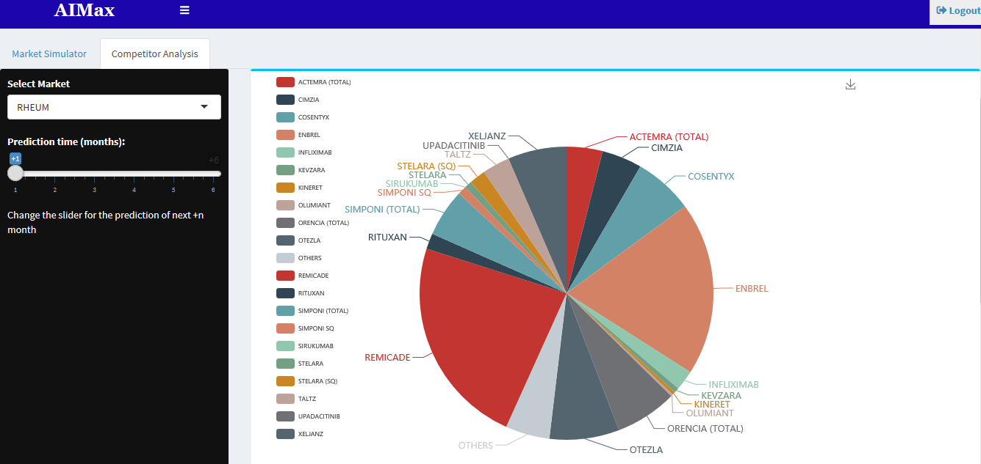
Competitor Performance Predictor

Slide 15
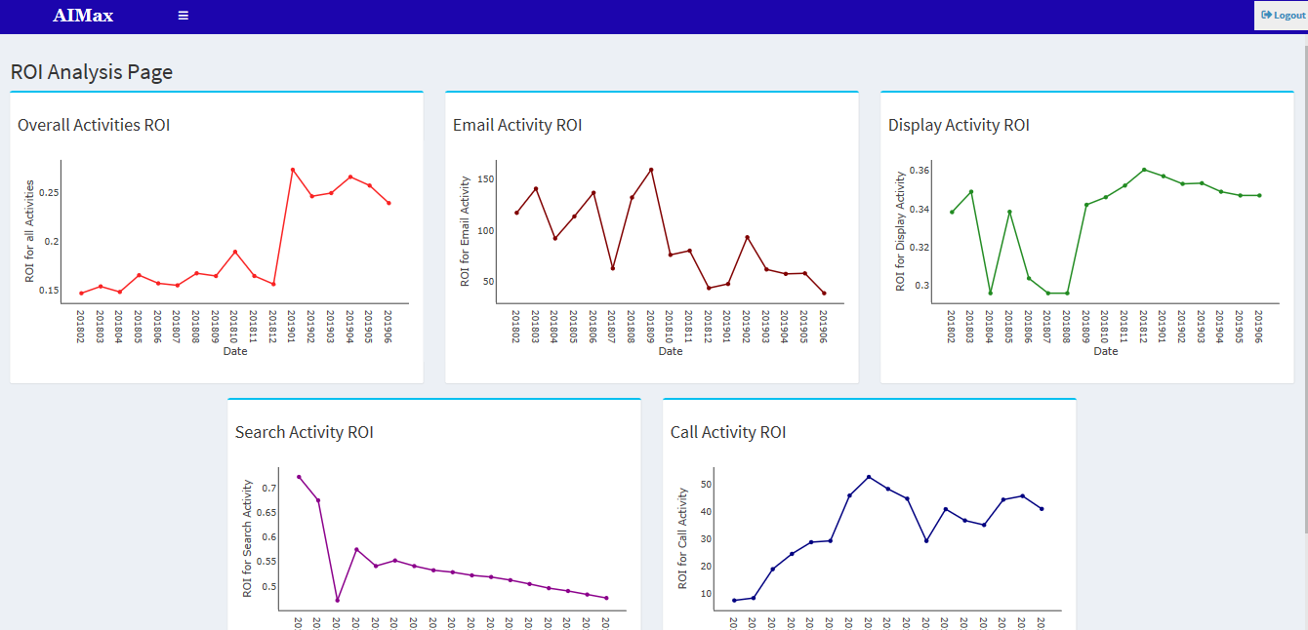
ROI Analysis

